Slide 1
GO TO MARKET STRATEGY FOR EBRO E-Vans in European Market
ALL CONSOLIDATED DELIVERABLES

Slide 2
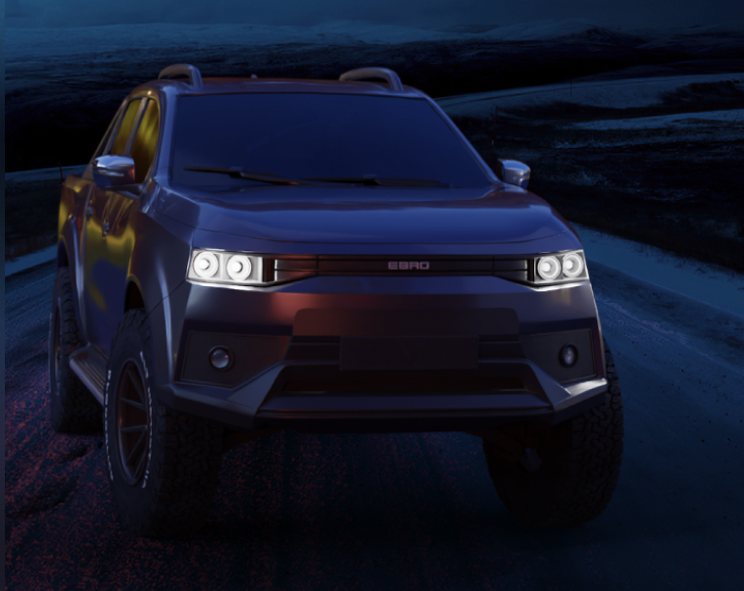
NEW PRODUCT LAUNCH
EBRO E-Van is an electric vehicle. It has a Wide range of customers as van and passenger vehicle (taxi) with an Excellent ratio between footprint and load volume. The vehicle is narrower than the existing competitors in the market (1.75m) making it ideal for urban transport (last mile). It has a capacity for two Euro pallets despite its small size. It has a great accessibility thanks to its two side doors . Besides all this it has Excellent ergonomics as a passenger vehicle. Extensive customization is possible in this vehicle. Above all it has a very competitive in price compared to its European competitors pool of the former Zona Franca plant.

Slide 3
PRODUCT SPECIFICATIONS
HIGHLIGHT
BATTERY
2 EUROPALET load capacity.
Flexibility versions, logistics, Taxi, entertainment.
Small size for city-urban movements (< 4,6m) - V2V and V2G capabilities.
Battery voltage pack: 230V.
City range: 280 km.
Combined range: 210 km.
Charge 0-80% AC 7kW - 6 hours
Charge 0-80% DC 40kW - 60 minutes
Dimensions: L=4560 x W=1755 x H=1858 mm
Axle base: 2750mm
Estimated weight kg: 1600 kg
Space capacity: 2950 .
DIMENSIONS
L=4560 x W=1755 x H=1858 mm
Axle base: 2750mm
Estimated weight kg: 1600 kg
Space capacity: 2950 l..
POWER TRAIN CONFIGURATION
One motor 250Nm torque- Front axle (FWD) .
Max speed 125 km/h
Load capacity: 750 kg + 2 occupant

Slide 4
THE 5 C FRAMEWORK

Slide 5
COMPANY
EBRO is a Spanish OEM that is empowered by a Catalan holding group specialized in engineering services present in automotive, aerospace, chemical, and other industrial sectors.
Its mission to Optimize and speed up the integration of electric mobility into day-to-day life, is all set to compete in the EV segment of Vans in the European market (Spain, France, Germany, Italy, and the UK) with its E-Van, EBRO LCV.
.

Slide 6
EBRO BELIEVES IN A SUSTAINABLE APPROACH AND IS COMMITTED TO 100% ELECTRIC MOBILITY
MISSION
Optimize and speed up the integration of electric mobility into day-to-day life.
VALUES
Technological innovation, communication, environmental responsibility, racing adventure, and authenticity.
VISION
Make electric mobility accessible, valuable and safe for everyone with the help of emerging technologies and racing experience.

Slide 7
BRIEF HISTORY

Slide 8
CLIMATE/ENVIRONMENT
EUROPEAN POPULATION
 | 2020 | 2024 | 2028 | 2032 | 2036 | 2040
Population in billion | 0.8463 | 0.8439 | 0.8428 | 0.8403 | 0.8366 | 0.8318
Population, 0-14 Years in million | 93.4 | 90.5 | 88.1 | 82.2 | 79.4 | 78.3
Population, 15-24 Years in million | 93.2 | 93.4 | 95.9 | 98.1 | 94.3 | 87.9
Population, 25-34 Years in million | 113.7 | 104.2 | 96.4 | 93.9 | 95.8 | 99.0
Population, 35-44 Years in million | 120.0 | 121.2 | 118.1 | 109.9 | 100.8 | 96.0
Population, 45-54 Years in million | 116.1 | 115.8 | 116.9 | 118.6 | 118.5 | 112.9
Population, 55+ Years in million | 309.9 | 318.9 | 327.4 | 337.5 | 347.8 | 357.8

Slide 9
GROSS DOMESTIC PRODUCT (GDP) OF EUROPEAN MARKET
 | 2020 | 2024 | 2028 | 2032 | 2036 | 2040
GDP (per Capita) in thousand USD (US$) | 25.8 | 32.8 | 38.1 | 43.3 | 48.1 | 52.3
Investment (% of GDP) | 22.5 | 22.3 | 22.3 | 22.3 | 22.3 | 22.3
CONSUMER SPENDING IN EUROPEAN MARKET
 | 2020 | 2024 | 2028 | 2032 | 2036 | 2040
Consumer Spending (per Capita) in thousand USD (US$) | 13.6 | 17.4 | 20.1 | 22.8 | 25.2 | 27.4
Consumer Spending, Housing (per Capita) in thousand USD (US$) | 3.4 | 4.1 | 4.8 | 5.5 | 6.1 | 6.7
Consumer Spending, Household Goods & Services (per Capita) in thousand USD (US$) | 0.8 | 1.0 | 1.1 | 1.3 | 1.4 | 1.5
Consumer Spending, Transportation (per Capita) in thousand USD (US$) | 1.6 | 2.2 | 2.5 | 2.8 | 3.1 | 3.3
Consumer Spending, Recreation & Culture (per Capita) in thousand USD (US$) | 1.1 | 1.4 | 1.6 | 1.8 | 2.0 | 2.1
Consumer Spending, Other Goods & Services (per Capita) in thousand USD (US$) | 1.6 | 2.0 | 2.3 | 2.6 | 2.8 | 3.1
Consumer Spending, Purchase of Vehicles (per Capita) in thousand USD (US$) | 0.5 | 0.6 | 0.7 | 0.8 | 0.9 | 0.9
Consumer Spending, Transport Services (per Capita) in thousand USD (US$) | 0.3 | 0.4 | 0.5 | 0.5 | 0.6 | 0.6

Slide 11
NET ZERO EMISSION PLEDGES 2025-2050

Slide 12
MARKET INSIGHTS
Although, the European Union population is expected to shrink by negligible amount by 2040, the GDP of EU states will considerably increase to 52.3 thousand USD by 2040 from 32.8 thousand USD in 2024. There is also a considerable increase in the consumer spending of per capita purchase of vehicles, which is expected to further allow growth in EV purchase. To corroborate the same, please refere to the EV market size in the previous slide which is expected to grow from a 261 billion dollar at present to 745 billion dollar in 2030
(SOURCE: STATISTA & MORDOR INTELLIGENCE)

Slide 13
CUSTOMER PROFILE
Electric vehicles (EVs) are no longer a niche business. They now account for 16 percent of new-car sales in Europe, up from under 1 percent in 2019. Despite the removal of purchase subsidies in certain markets, such as Germany at the end of 2023, sales have remained stable. Since the beginning of 2024, more than 875,000 new full battery electric vehicles (BEVs) have been sold across the continent.
A recent survey by Mckinsey & Company has been done in order to understand European consumers’ views on EVs and key market trends, individuals from France, Germany, Italy, and Norway were a part of this McKinsey Mobility Consumer Pulse Survey, which closely monitors consumer perceptions about the future of mobility in general in EV Segment.

Slide 14
Intent to purchase an EV is slightly higher in the premium-brand segment, as well as among younger and more progressive urban customers, who tend to be environmentally conscious. But interest in EVs is now expanding beyond these groups, and the next wave of buyers may include more older consumers with comparatively lower budgets. In other words, more mainstream buyers could follow the first movers who initially adopted EVs. As the consumer base shifts, customer expectations for EVs will also evolve and manufacturers must be prepared to meet them.

Slide 15
SURVEY FINDINGS
The survey findings suggest that a longer driving range and relatively low purchase could accelerate BEV adoption in Europe, since buyers in this region have high expectations for the real battery driving range. In McKinsey's survey, consumers who would consider an EV but have not yet purchased one, states that the driving range would need to be about 500 kilometers for them to switch from an internal combustion engine (ICE) vehicle to a fully electric BEV (Exhibit 3). Among current BEV owners, expectations for driving range are only slightly lower, at about 470 kilometers.
REFERENCE: https://www.mckinsey.com/industries/automotive-and-assembly/our-insights/how-european-consumers-perceive-electric-vehicles

Slide 16
COMPETITORS

Slide 17
LEADING COMPETITORS
Groupe Renault, is one of the leading players in the electric cars segment in Europe thanks to the sales of its all-electric Van Kangoo, The 2024 Renault Kangoo van continues to offer practicality and versatility for both professional and personal use. The Kangoo's boxy design maximizes the available interior space, making it ideal for those needing to transport bulky items or requiring ample passenger room. The sliding rear doors provide easy access to cargo in tight parking spaces. When behind the wheel, the 2024 Kangoo offers a comfortable ride and decent handling for its class. The electric version, in particular, provides smooth, quiet operation well-suited to urban environment’s.Pricing across the Renault Kangoo range remains extremely competitive within the compact segment which means the van remains a solid choice for practical-minded buyers seeking a versatile vehicle for commercial use.
CITROËN Ë-BERLINGO , a fully electric LCV is perfect for eco-conscious trades people and businesses. One can reap the benefits of the ë-Berlingo Electric, including lower running costs, zero emissions, a competitive driving range, and an impressive payload capacity.The ë-Berlingo Electric offers flexibility for both passengers and cargo. One can choose from two sizes (M and XL) and configure seating for two or three people. Plus, select the ideal trim level for your needs – Enterprise Pro or Driver Pro. The Citroën ë-Berlingo uses a 100kW electric motor which is paired to a 50kWh battery pack which is located under the load floor. The van has a range of 171 miles which is plenty for daily commuting and working between different jobs in and around London. A standard 7.4kW domestic wall box will charge the battery in seven and a half hours. Fast charging is also included, with a 100kW rapid charger taking the battery from 0-80% in just 30 minutes.
Its setup is the same as it's closely-related sister vans: Peugeot e-Partner, Vauxhall Combo-e and the Toyota Proace City Electric.

Slide 18
THE MAXUS EDELIVER 3 sits right on the border between typical small vans and medium vans, with a load space that’s slightly bigger than the former but more compact than what’s typical for the latter. The Maxus eDeliver 3 originally came with a choice of two battery sizes, 35 kWh and 50.23 kWh, both using the same type of 'tenary lithium polymer' technology that's also used by Tesla. this gives the eDeliver 3 a 'combined' driving range per charge of 99 miles or 151 miles, respectively. This increases speed to 141 miles or 213 miles in exclusively urban driving, where the stop and start of traffic helps keep the batteries topped up. Using a DC rapid charger of the type found on the public charging network, an 85% charge takes 45 minutes for either battery pack size.Using the type of AC charging found in domestic or workplace wallbox chargers, you’ll need six hours for the smaller battery and eight hours for the larger battery – though that is to 100%.
.
The CENNTRO LOGISTAR 200 has a length of 5.5 meters, a width of 1.85 meters and a height of 2 meters, it offers a load capacity of 7.5 cubic meters, two side loading doors and convenient rear doors with a cargo opening of up to 270°.Together with a payload of around 1,280 kilograms and a range of up to 270 kilometers (167 miles), the logistar 200 is aimed at a wide range of applications for skilled trades, courier, express and parcel services, logistics solutions and facility management.“The logistar 200 rounds out Cenntro’s commercial vehicle line-up, providing fleets and businesses with best-in-class EV technology that supports the most robust operating cycles,

Slide 19
SPECIFICATION | RENAULT KANGOO E-TECH | CITROEN E-BERLINGO | PEUGEOT E-PARTNER | MAXUS E-DELIVER 3 | CENNTRO LOGISTAR 200 | EBRO - EVAN
VEHICLE TYPE | Electric Compact Van | Electric Compact Van | Electric Compact Van | Electric Small Van | Electric Light Commercial Van | Electric Small Van
BATTERY CAPACITY | 45 kWh | 50 kWh | 50 kWh | 35 kWh or 52.5 kWh | 41 kWh | 40 kWh (MOST LIKELY)
RANGE (WLTP) | Up to 285 km | Up to 275 km | Up to 275 km | 200 km (35 kWh), 342 km (52.5 kWh) | Up to 200 km | Up to 280 km
PAYLOAD CAPACITY | Up to 600 kg | Up to 800 kg | Up to 800 kg | 945 kg | 540 kg | 705 kg (MOST LIKELY)
CARGO VOLUME | 3.9 m³ to 4.9 m³ | 4.4 m³ | 4.4 m³ | 4.8 m³ (short) - 6.3 m³ (long) | 5 m³ | 4.2 m³ (MOST LIKELY)
CHARGING TIME (AC) | 7 hours (7.4 kW) | 7.5 hours (7.4 kW) | 7 hours (7.4 kW) | 6-8 hours (AC 7.2 kW) | 6-8 hours | 0-80% 7 kW – (6 hours)
FAST CHARGING (DC) | 80% in 42 minutes (80 kW DC) | 80% in 30 minutes (100 kW) | 80% in 30 minutes (100 kW) | 45 minutes (80% charge, 50 kW DC) | 30 minutes (20%-80%, 50 kW DC) | 60 minutes (80%, 40 kW DC)
TOP SPEED | 135 km/h | 130 km/h | 130 km/h | 120 km/h | 100 km/h | 125 km/h
POWER OUTPUT | 90 kW (120 hp) | 100 kW (136 hp) | 100 kW (136 hp) | 90 kW (122 hp) | 60 kW (80 hp) | 80 kW (107 hp) (MOST LIKELY)
PRICE RANGE (EUROPE) | Starting from €32,000 | Starting from €30,000 | Starting from €30,000 | Starting from €29,000 | Approx. €25,000 | AVG Price €35,000

Slide 20
COLLABORATORS
CHERY AUTOMOBILE: The Chinese automaker Chery has entered a joint venture with EBRO-EV Motors. This partnership will focus on producing electric vehicles, including Chery's Omoda models and EBRO-branded cars. The collaboration is significant as it marks Chery’s first manufacturing plant in Europe. Chery will leverage its global experience in electric vehicle production, while EBRO will provide local expertise and facilities at the former Nissan plant in Zona Franca​.
BARCELONA TECHNICAL CENTRE : Ebro and Barcelona Technical Center (BTech) have a close collaboration, particularly in the reindustrialization of the former Nissan plant in Barcelona. Together, they are part of the Decarbonization Hub (D-Hub) initiative, which aims to transform the factory into a center for electric vehicle production. BTech plays a key engineering role in this effort, focusing on the design and assembly of Ebro's electric vehicles, including its upcoming electric pickup truck.
As one of the leading partners in D-Hub, BTech is helping Ebro manufacture 40,000 units annually, contributing to the larger goal of producing 100,000 electric vehicles at the site when combined with other manufacturers like Zeroid. Their role is essential in reviving the Ebro brand and facilitating the production of electric vehicles that will launch by 2025
CATALAN GOVERNMENT (ACCIÓ-CATALONIA TRADE & INVESTMENT) & SPANISH GOVERNMENT: The Catalan government & Spanish Government played a crucial role in securing EBRO-CHERY collaboration, facilitating discussions between Chery and EBRO. This partnership is seen as part of Catalonia's broader strategy to enhance its position as a hub for smart and sustainable mobility.

Slide 21
GO TO MARKET STRATEGY
FOR
EBRO
E-VAN

Slide 22
TYPE OF GTM FOR EBRO
The global electric vehicle market is growing rapidly, with projections suggesting that it could reach $802.81 billion by 2027. This growth is primarily due to the increasing government support for EVs, rising environmental concerns, and advancements in EV technology. Governments around the world are offering incentives for people to purchase EVs, such as tax credits and rebates, which is driving up demand. In addition, the cost of EVs is decreasing as battery technology improves, making them more affordable for consumers.
Firstly, we are launching a new product in existing market i.e EBRO E-VAN, therefore, we need to align our Go To Market strategy on similar lines
Secondly, we would be focusing on sales led Go To Market strategy

Slide 23
MARKET DEMAND
The demand for commercial vehicles is set to witness a significant uptick in the coming years. Key drivers of this growth include the logistics, supply chain, infrastructure, and construction sectors. Additionally, a rise in public transportation services is bolstering the demand for buses.

Slide 24
However, the sales of commercial vehicles & passenger vehicle experienced a downturn in 2020, largely due to the impact of the pandemic. The market swiftly rebounded in 2021, with Europe's Climate Plan playing a pivotal role. As Europe aims to ban diesel-powered vehicles by 2030, a notable shift is expected to be witnessed among business consumers toward electric commercial vehicles and also in passenger vehicles.
The demand for commercial & passenger vehicles is set to witness a significant uptick in the coming years. Key drivers of this growth include the logistics, supply chain, infrastructure, and construction sectors. Additionally, a rise in public transportation services is bolstering the demand for buses.

Slide 25
CUSTOMER SEGMENTATION
FAMILY TRANSPORTATION
COMMERCIAL SEGMENT
Narrower vehicle than the
competition (1.75m) making it Ideal for urban transport.
Last mile EV Van for urban mobility, also available for 7 passengers.
Excellent ergonomics as
a passenger vehicle
European production vehicle. Extensive customisation possibilitie
B2B/G ORIENTED
Companies and fleets
Public Services (Police, Firefighters, emergency services, maintenance….)
CAB Services
B2B SERVICES
Acquisition services
Charge network and sustainable projects
Power supply Management
Connected Vehicle (Fleet management)

Slide 26
BRAND POSITIONING
EBRO Evan is based on Nissan Env200. E-Van is an electric vehicle with proven experience in the market as evident from sale of several units of the NV200 already sold.
Wide range of customers as van and passenger vehicle (taxi) (last mile)
Excellent ratio between footprint and load volume. Narrower vehicle than the competition (1.75m) making it ideal for urban transport
Capacity for two Euro pallets despite its small size. Great accessibility thanks to its two side doors • Excellent ergonomics as a passenger vehicle
European production vehicle.
Extensive customization possibilities
Very competitive in price compared to its European competitor

Slide 27
SEVEN STEPS TO POSITION
STEP 1 : CREATE CHARGING INFRA AS A USP

Slide 28
STEP 2 RE- INVENT BRAND POSITIONING
EBRO can develop the charging network of its own or can make a tie up with a large charging network.
EBRO can offer attractive new offerings like integrated EV-mobility bundles that include products and services, with a focus on the overall experience. In addition to the vehicle itself, a successful bundle might include charging, on-demand features and services, financing options, mobility services, after sales packages and extended warranties. Combined, these elements could create a compelling offer that enhances the customer experience and may resolve concerns that could hinder the adoption of EVs.
EBRO can use innovative and personalized approaches, such as digital campaigns, to reach and educate prospective EV customers. Focusing on areas and customer segments that are actively considering Evs. This step will be critical to reach scale quickly and to create a network of EV advocates for each the brand.

Slide 29
STEP 3 GENERATE INCOME FROM LIFE CYCLE
After the purchase, EBRO can, for example, offer on-demand services and features to consumers, as Tesla does through its Auto Pilot. Such features might include performance and battery-boosting software, advanced driver-assistance systems, and services like BMW Connected Drive, which includes remote services, concierge service, and on-street parking information, among other benefits. BMW, for example, offers Connected Drive in four packages that cost from €69 to €279 a year.Given the attractive profit margins on those services, BMW is able to bolster the overall profitability of its EVs.
Either alone or with the support of third-party data aggregators, EBRO also have an opportunity to generate revenues from the data of customers and vehicles. These data could be used to address a number of use cases involving connected vehicles, to offer personalized services, or to provide third-party marketing. Revenues from data could also be generated as an additional revenue stream.

Slide 30
STEP 4 BUILD RELIABLE DISTRIBUTION CHANNELS & DEALER PARTNERSHIPS
EBRO must not only support their dealers as they build the required infrastructure and capabilities but also, at the same time, provide incentives that make EV VAN sales more economically attractive over the long term. Without such efforts, dealers may wonder if it is worthwhile to sell EVs.
EBRO should monitor performance—both their own and that of third-party dealers—to ensure the consistent delivery of an optimal EV sales pitch. They should also invest in digitally savvy product “geniuses” to serve as trusted advisers for customers. To build the deep EV expertise that makes it possible to address all relevant customer concerns, EBRO should train the geniuses through online and in-person classes that explain integrated EV-mobility bundles.
EBRO should also give dealers incentives to increase the number of test drives, which would expose more customers to the new technology. EBRO could, for instance, encourage dealers to reach out to target groups, such as taxi companies and mobility providers, to get additional prospective customers behind the EV wheel.
Finally, EBRO should ensure that all showrooms prominently display the entire EV portfolio (including wall box and charging solutions) and that customers can explore them with digital tools.

Slide 32
FINAL CUSTOMER/USER

Slide 33
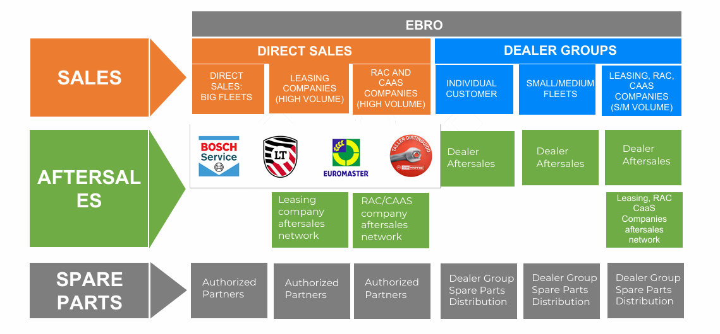
AFTER SALES & SPARE PARTS

Slide 34
STEP 5 CREATE OMNI CHANNEL STRATEGY FOR DIGITAL PRESENCE
EBRO should invest significantly in their digital presence to provide easy access to information about important customer concerns; for example, OEMs could feature discussions about customers’ key EV pain points on their websites. They could also reduce the complexity and uncertainty of a purchase by providing simple, care-free configuration and ownership options, such as subscription models that permit further personalization through on-demand features.
Ensuring seamless online–offline integration between digital touch points and dealers is important too. First, it helps dealers identify likely customers for EVs. Given the central role of online channels during the information phase, they will also have a growing importance in generating leads. Several EV manufacturers have proved that innovative online–offline integration and hyper local marketing can significantly increase walk-in rates.
Since more than 50 percent of prospective EV customers would be willing to purchase a car online, EBRO should also begin to pilot online sales approaches, as Tesla does, to provide a lean, cost-effective retail channel with direct access to customers.

Slide 35
STEP 6 UPGRADED AFTER SALES SERVICES BOTH ONLINE & OFFLINE
EVs require less after-sales service than ICE vehicles do and have significantly different maintenance needs. They also require highly skilled technicians who understand battery and high-voltage technology.
EBRO should therefore develop EV-specific training programs—in battery diagnostics, for example—to train the technicians in their dealer networks. It will also be important to ensure that EV-related parts and tools, such as battery-leak detectors, are easily available.
EBRO and its dealers should also create EV-specific service offerings and maintenance plans. EVs will have complex proprietary software. For after-sales service, many consumers will rely on the dealer networks affiliated with their cars, and that could partially compensate for lower profits in the overall EV after-sales and parts market. EBRO could also create EV-specific offerings to reassure customers by providing additional battery-related support (such as recharging services) via service partners. Such offerings might include long-distance replacement cars or distinctive warranty offers—for example, a battery-care package (similar to Apple Care).

Slide 36
ONLINE & OFFLINE AFTER SALES SERVICES
EBRO could provide state-of-the-art after-sales services (such as parts-exchange reminders and software updates) that are always available and can be sent, in part, remotely over the air. Such services could significantly improve the customer experience.

Slide 37
STEP 7 CREATE A COMPETITIVE PRICING STRATEGY
KEY ELEMENTS TO CONSIDER
GOVERNMENT INCENTIVES: We need to analyze the different government subsidies and tax breaks available in each European country, as they can significantly impact the final price of an EV for consumers.
BATTERY TECHNOLOGY AND RANGE: Price EVs based on their battery capacity and driving range, as these are key factors influencing consumer choice.
CHARGING INFRASTRUCTURE: Consider the availability and cost of charging infrastructure in different regions, as this can affect the overall ownership cost for consumers.
COMPETITOR PRICING: Monitor the pricing strategies of other EV manufacturers in the European market to remain competitive.
MARKET SEGMENTATION: Identify different consumer segments (e.g., budget-conscious, premium, eco-conscious) and develop targeted pricing strategies for each group.
DYNAMIC PRICING: Explore the potential for dynamic pricing models where charging costs can vary depending on time of day, location, or grid demand.

Slide 38
STEP 8 CREATE A MEDIA MARKETING STRATEGY
CREATE A MEDIA MARKETING STRATEGY THAT INCLUDES:
Interactive Omni channel based website offering 3d Images of the Vehicle with all the product details and specifications, both of exteriors as well as interiors. It should also provide services on after sales and pre sales. Besides, it should also have an AI bot assisting customers on different fronts.
Promotions should be done through social media channels i.e Instagram, Facebook and Youtube. Social media influencers should be engaged to increase promotion and marketing online.

Slide 39
Extensive promotions to be done at various Motor shows and Auto Exhibitions occuring throughout Europe before actual lauch of vehicle through a dedicated brand ambassador, who people can relate to throughout the markets where the Van is being launched.
Active participation in motor shows and Rallies would help the brand to get an off showroom and on road image. It will also help EBRO E-Van to showcase its performance, power and endurance.
EBRO can built a strong customer community and could help bridge the gap among customers and company by regularly engaging with these customers at different level. This would help the company to improve its product continuously by obtaining feed back.
By SEO and Content Marketing EBRO can create informative content around the benefits of electric commercial vehicles, fleet management, and sustainability. Optimize for search terms like “electric vans Europe” or “sustainable fleet solutions.”
Develop email marketing campaigns focused on fleet managers, small businesses, and city-based service providers. Use segmentation to send tailored content to different industry verticals.
Collaborate with Charging Infrastructure Providers i.e one can form partnerships with companies like Ionity or ChargePoint to offer bundled solutions, including charging plans or discounted charging stations for fleet customers.
Free Trial Programs can be offered to businesses as the opportunity to test the EV van in their fleet for a limited time to experience its benefits.

Slide 40
Extensive promotions to be done at various Motor shows and Auto Exhibitions occuring throughout Europe before actual lauch of vehicle through a dedicated brand ambassador, who people can relate to throughout the markets where the Van is being launched.
Active participation in motor shows and Rallies would help the brand to get an off showroom and on road image. It will also help EBRO E-Van to showcase its performance, power and endurance.
EBRO can built a strong customer community and could help bridge the gap among customers and company by regularly engaging with these customers at different level. This would help the company to improve its product continuously by obtaining feed back.
By SEO and Content Marketing EBRO can create informative content around the benefits of electric commercial vehicles, fleet management, and sustainability. Optimize for search terms like “electric vans Europe” or “sustainable fleet solutions.”
Develop email marketing campaigns focused on fleet managers, small businesses, and city-based service providers. Use segmentation to send tailored content to different industry verticals.
Collaborate with Charging Infrastructure Providers i.e one can form partnerships with companies like Ionity or ChargePoint to offer bundled solutions, including charging plans or discounted charging stations for fleet customers.
Free Trial Programs can be offered to businesses as the opportunity to test the EV van in their fleet for a limited time to experience its benefits.

Slide 41
Mobile App for Fleet Management: or web-based tool for fleet managers to monitor their EV van performance, track charging status, and manage routes efficiently can be offered.
Develop case studies from early adopters, especially businesses that improved their operational efficiency or saved on costs by switching to electric vans.
Get coverage in major European media outlets (e.g., The Guardian, Le Monde etc) and automotive-specific platforms like Autocar or Electrek.

Slide 42
Thank you!

